Slide 1
Additional Genetic Patterns
Mendel’s peas | Other Patterns
Complete Dominance | Incomplete Dominance Codominance Lethal Alleles Hierarchy of Dominance
Two alleles per gene | Multiple Alleles
One gene affects one trait | …Many traits (Pleiotropy) Two (or more) genes affect one trait (Gene Interactions and Polygenic Traits)
Notes:
‹#›

Slide 2
Additional Genetic Patterns
Mendel’s peas | Other Patterns
Could not observe gender-specific traits | Sex-influenced traits Sex-limited traits
Equal contributions from both parents | Cytoplasmic Inheritance Genetic Maternal Effect Genomic Imprinting
Trait expressed at same level and stage of life | Anticipation
No environmental influence | Environmental Effects
Notes:
‹#›

Slide 3
Incomplete Dominance
Incomplete dominance: neither allele masks the other and both are observed as a blending in the heterozygote
RR x R’R’
Red White
Four o’clock flowers
R = red, R’ = white
RR’
pink

Slide 4
Incomplete Dominance
RR’ x RR’
Pink x Pink
Genotypic Ratio: Phenotypic Ratio:

Slide 5
Multiple Alleles
Multiple alleles: three or more alleles exist for one trait
(Note: A diploid individual can only carry two alleles at once.)
Blood Type | Allele
Type A | I^{A}
Type B | I^{B}
Type O | i

Slide 6
Codominance
Codominance: Neither allele masks the other so that effects of both alleles are observed in heterozygote without blending
I^{A} = I^{B} > i
I^{A} and I^{B} are codominant.
I^{A} and I^{B} are completely dominant over i.

Slide 7
Codominance
Phenotype | Genotype | Gene Product | Antibodies Present
Type A | I^{A}I^{A} or I^{A}i | Antigen A | Anti-B
Type B | I^{B}I^{B} or I^{B}i | Antigen B | Anti-A
Type AB | I^{A}I^{B} | Antigen A and Antigen B | Neither Anti-A nor Anti-B
Type O | ii | none | Anti-A and Anti-B

Slide 8
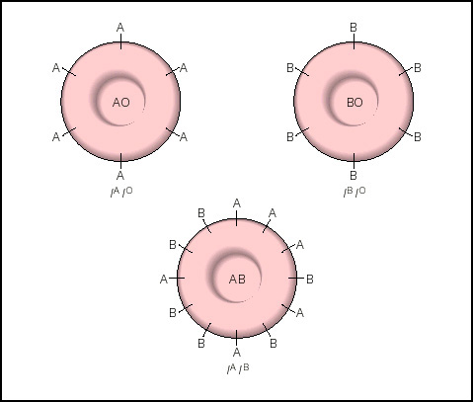
Antigens on Red Blood Cells
I^{A}i
I^{B}i
I^{A}I^{B}

Slide 9
Inheritance of Rh Factor
Phenotype | Genotype* | Gene Product | Antibodies Present
Rh Positive | RR or Rr | Rhesus Protein | None
Rh Negative | rr | None | None unless exposed
*There are multiple alleles for the Rhesus protein
(R₁, R₂, R₃, etc.) and all are dominant to the multiple
alleles for the absence of Rhesus protein (r₁, r₂, r₃, etc.) .

Slide 10
Multiple Alleles and Codominance
Type A, Rh positive x Type B, Rh negative
(father is Type O, Rh negative) (mother is Type O)
Phenotypic Ratio of Offspring

Slide 11
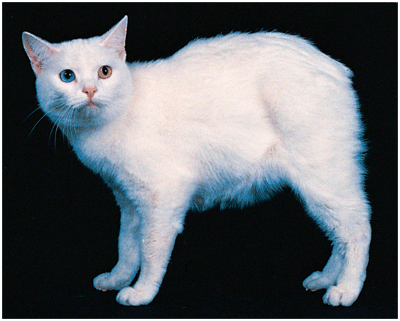
Lethal Alleles
Example: Manx cat
M^{L} = tailless, lethal in homozygote
m = tail
Tailless male x Tailless female

Slide 12
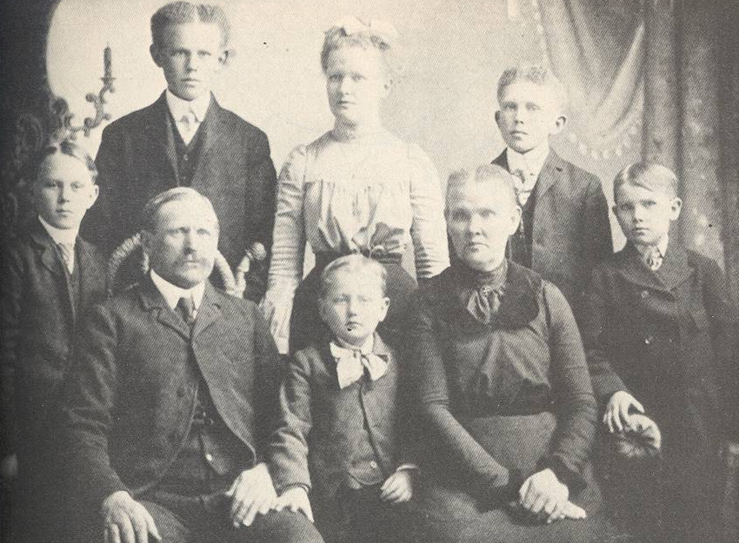
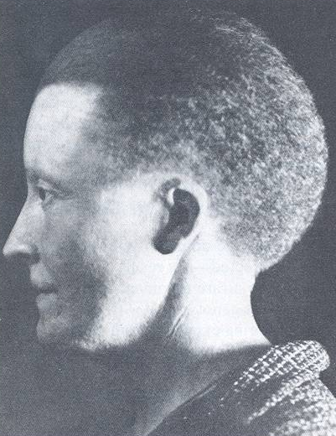
Hierarchy of Dominance
Example: hair curling
S^{w} = wooly S^{c}= curly S^{wa}= wavy s = straight
S^{w}> S^{c}> S^{wa}> s

Slide 13
Hierarchy of Dominance
Dad Colavito has wavy hair.
Mom Colavito has curly hair.
Their daughter Jean has straight hair.
What are the expected genotypic and
phenotypic ratios for their offspring?
S^{w}> S^{c}> S^{wa}> s

Slide 14
Hierarchy of Dominance
Dad C x Mom C
Wavy Curly
S^{w}> S^{c}> S^{wa}> s
Bonus: What is Dr. C’s genotype?

Slide 15
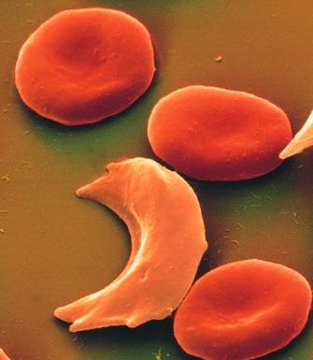
Pleiotropic Effects
One gene affects many phenotypic characteristics
Allele | S | S’
Gene Product | Hemoglobin A | Hemoglobin S
Cell Shape | Round | Sickled under low O₂ tension
Response to Malaria | Susceptible | Resistant in SS’ genotype

Slide 16
Example of Polygenic Inheritance
Two genes affecting skin coloration
Number of Dominant Alleles | Skin Color* (Phenotype) | Genotypes | % Pigmentation
0 | White | aabb | 0-11%
1 | Light Black | Aabb or aaBb | 12-25%
2 | Medium Black | AAbb or AaBb or aaBB | 26-40%
3 | Dark Black | AABb or AaBB | 41-55%
4 | Darkest Black | AABB | 56-78%
*Based on a study conducted in Jamaica.

Slide 17
Polygenic Inheritance
Medium Black Woman
(mother is white)
X Darkest Black Man

Slide 18
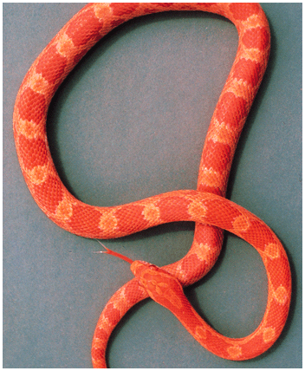
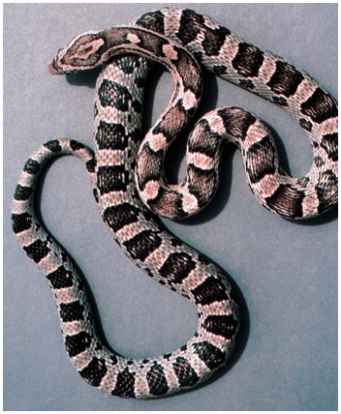
Interacting Genes Affecting a Single Characteristic
eg. Skin coloration in snakes
One gene
O = orange pigment
o = no orange pigment
Second gene
B = black pigment
b = no black pigment

Slide 19
Interacting Genes Affecting a Single Characteristic
eg. Skin coloration in snakes
Oo Bb x Oo Bb
OB
Ob
o B
o b
OO BB | OOBb | Oo BB | Oo Bb
OO Bb | OO bb | Oo Bb | Oo bb
Oo BB | Oo Bb | o o BB | o o Bb
Oo Bb | Oo b b | o o Bb | o o b b
OB
Ob
o B
o b

Slide 20
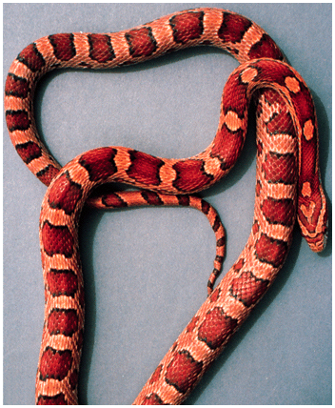
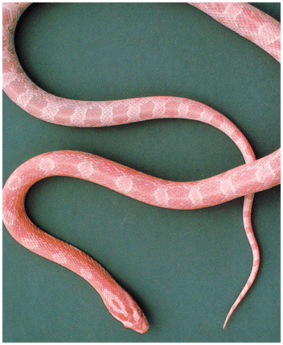
Interacting Genes Affecting a Single Characteristic
eg. Skin coloration in snakes
OoBb x OoBb
9/16 O_B_ 3/16 O_bb 3/16 ooB_ 1/16 oobb

Slide 21
Epistasis
An allele of one gene masks the expression of alleles of another gene and expresses its own phenotype instead.
Gene that masks = epistatic gene
Gene that is masked = hypostatic gene
Genes that code for enzymes that are upstream in a biochemical pathway usually exert epistasis (“standing on”).

Slide 22
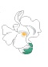
Recessive Epistasis
Epistatic gene exerts its affect with homozygous recessive genotype.
eg. Petal color in blue-eyed Mary plants
mm= magenta, ww =white, W__M__= blue
W
M
enzyme 1
enzyme 2
Precursor 1🡪 Precursor 2🡪blue anthocyanin
colorless magenta

Slide 23
Recessive Epistasis
eg. Petal color in blue-eyed Mary plants
W w M m x W w M m
9/16 W __ M__
3/16 W __ mm
3/16 w w M__
1/16 w w mm
Phenotypic ratio:

Slide 24
Duplicate Recessive Epistasis
Defective products of recessive alleles of two different genes interfere with separate steps in a biochemical pathway.
eg. Petal color in harebell flowers
ww = white, bb = white, W_ B_ = blue
W
B
enzyme 1
enzyme 2
Precursor 1🡪 Precursor 2🡪blue anthocyanin
colorless colorless

Slide 25
Duplicate Recessive Epistasis
eg. Petal color in harebell flowers
W w B b x W w B b
9/16 W __B__
3/16 W __ b b
3/16 w w B__
1/16 w w b b
Phenotypic ratio:

Slide 26
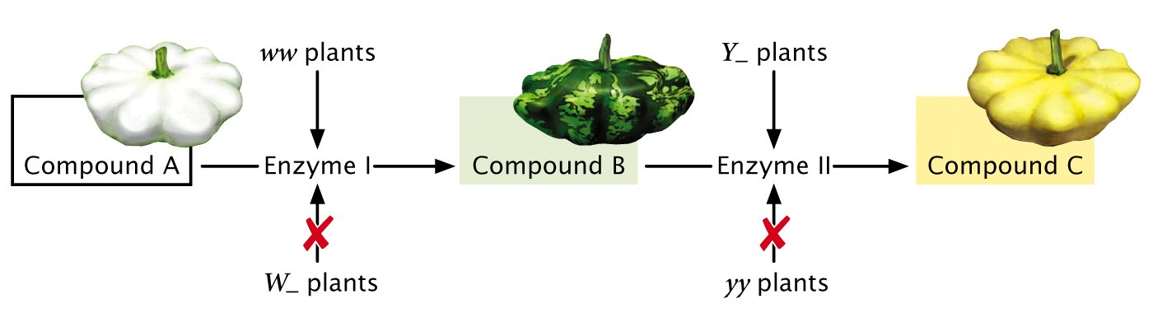
Dominant Epistasis
Epistatic gene exerts its affect with the presence of a dominant allele. eg. Fruit color in summer squash
Y = yellow, yy = green;
W inhibits either color = white; w has no effect on color

Slide 27
Dominant Epistasis
eg. Fruit color in summer squash
W w Y y x W w Y y
9/16 W __ Y__
3/16 W __ yy
3/16 w w Y__
1/16 w w yy
Phenotypic ratio:

Slide 28
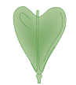
Duplicate Dominant Epistasis
eg. Fruit shape in Shepherd’s purse
A_ or B_ = heart shape
aa and bb = narrow shape

Slide 29
Duplicate Dominant Epistasis
eg. Fruit shape in Shepherd’s purse
A_ or B_ = heart aa and bb = narrow
A a B b x A a B b
9/16 A__B__
3/16 A__b b
3/16 a a B__
1/16 a a b b
Phenotypic ratio:

Slide 30
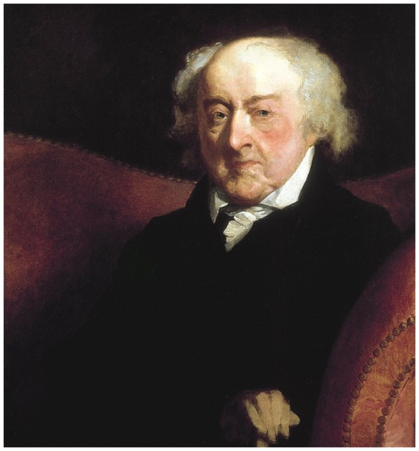
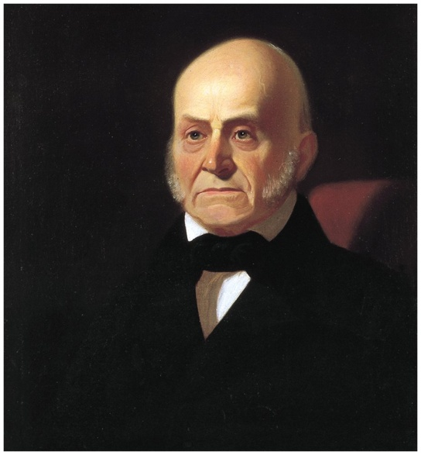
Interaction between Sex and Heredity
Sex-influenced characteristic | Determined by autosomal genes Expression differs by gender
John Adams
John Quincy Adams
Male pattern baldness
Dominant in males, recessive in females

Slide 31
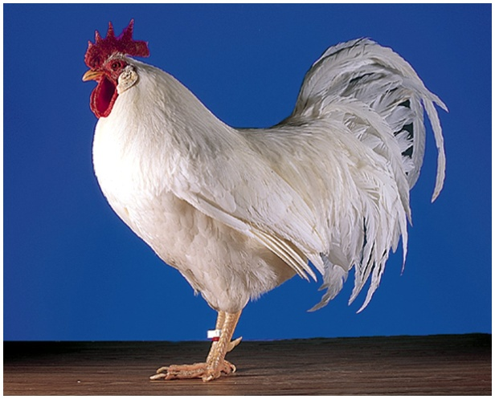
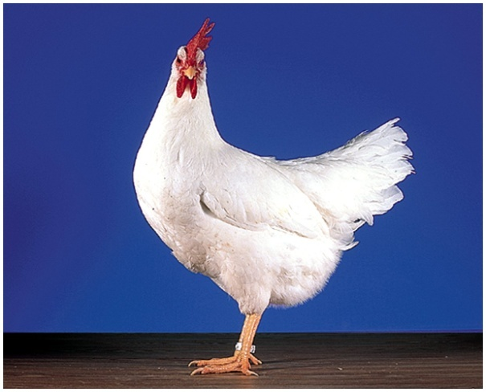
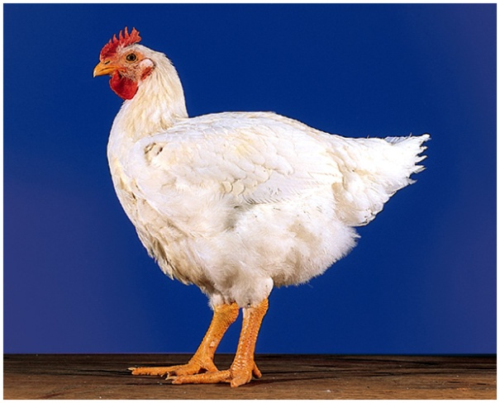
Interaction between Sex and Heredity
Sex-limited characteristic | Determined by autosomal genes Expressed only in one gender
Cock-feathered male
Hen-feathered female
Hen-feathered male
Cock feathering, autosomal recessive
Expressed only in males

Slide 32
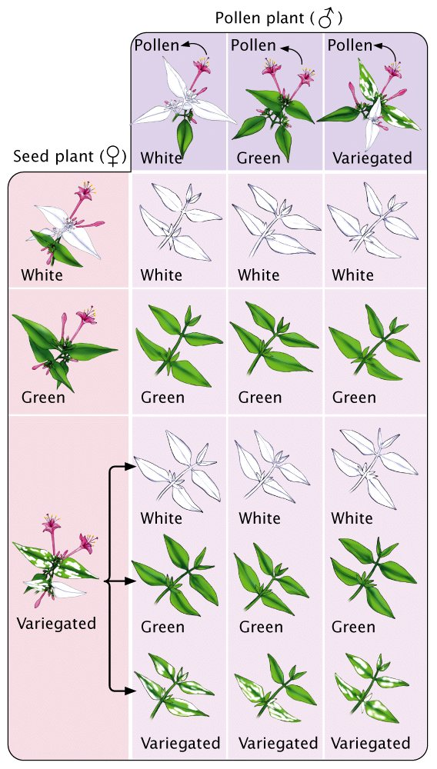
Interaction between Sex and Heredity
Cytoplasmic Inheritance
Genes found on chromosomes of cytoplasmic organelles Inherited from the maternal parent due to contribution of cytoplasm in ovum
Leaf variegation caused by inheritance of variable chloroplast genotypes

Slide 33
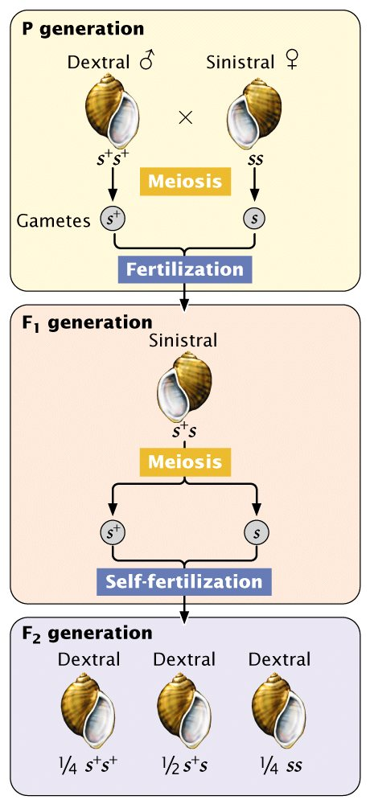
Interaction between Sex and Heredity
Genetic Maternal Effect
Phenotype of offspring depends on genotype of the maternal parent
Direction of snail shell coiling is determined by genotype of female parent

Slide 34
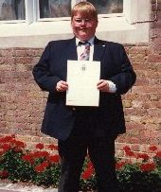
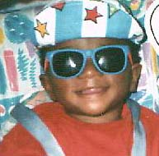
Interaction Between Sex and Heredity
Genomic Imprinting | Expression of autosomal genes differs depending on whether they are inherited from the male or female parent
Prader-Willi Syndrome Deletion on chromosome 15 inherited from father
Angelman Syndrome Deletion on chromosome 15 inherited from mother

Slide 35
Anticipation
Trait is more strongly expressed or expressed earlier in succeeding generations
Huntington Disease | Increase in number of trinucleotide repeats in gene for protein Huntingtin leads to lethal neurodegenerative disorder with personality changes and uncontrollable movements. Number of repeats expands with succeeding generations. Disease occurs earlier and is more severe.

Slide 36
Expansion of the Trinucleotide Repeat for Huntington’s Disease
Allen
(46,13)
age 50
Linda
(6,22)
Jama
(7,18)
Andrew
(69,6)
age 37
Kristen
(64,22)
age 40
Ann
(64,22)
age 39
Greg
(11,19)
Debbie
(13,6)
Bill
(8,12)
Christina
(93,7)
age 26
Joseph
(7,6)
Nathaniel
(72,19)
age 35
Paula
(13,12)
Evan
(not tested)

Slide 37
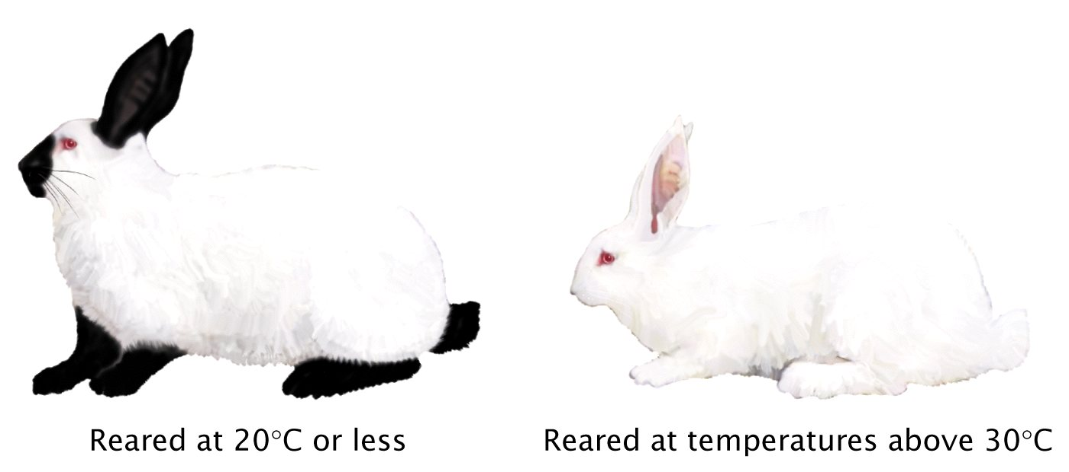
Environmental Effects
Phenotype is dependent upon the presence of a specific environment.
The temperature-sensitive product of the himalayan allele is inactivated at high temperatures.

Slide 38
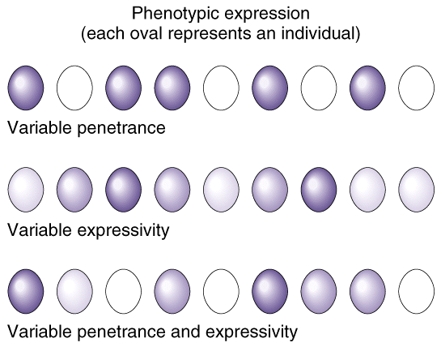
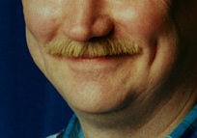
Penetrance and Expressivity
Penetrance = percentage of individuals with a given genotype who exhibit the phenotype
Expressivity = extent to which genotype is expressed at the phenotypic level (may be due to allelic variation or environmental factors)

